Slide 1
Unit-1 Software Development Approaches
Dr. Durgansh Sharma

Slide 2
Software Development Methodologies
Waterfall Model | Prototype Model | Agile software development
Rapid Application Development | Dynamic Systems Development Model | Spiral Model
Extreme Programming | Feature Driven Development | Joint Application Development
Lean Development | Rational Unified Process | Scrum Development

Slide 3
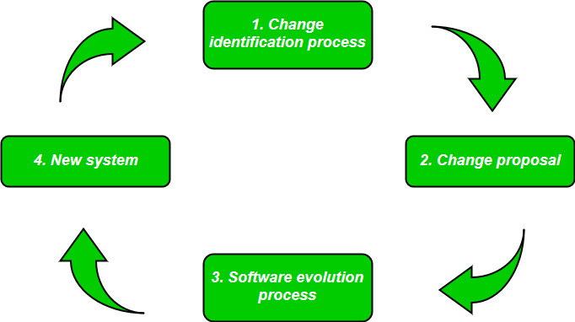
Software Evolution

Slide 4
Laws of Software Evolution
Law of continuing change: This law states that any software system that represents some real-world reality undergoes continuous change or become progressively less useful in that environment.
Law of increasing complexity: As an evolving program changes, its structure becomes more complex unless effective efforts are made to avoid this phenomenon.
Law of conservation of organization stability: Over the lifetime of a program, the rate of development of that program is approximately constant and independent of the resource devoted to system development.
Law of conservation of familiarity: This law states that during the active lifetime of the program, changes made in the successive release are almost constant.

Slide 5
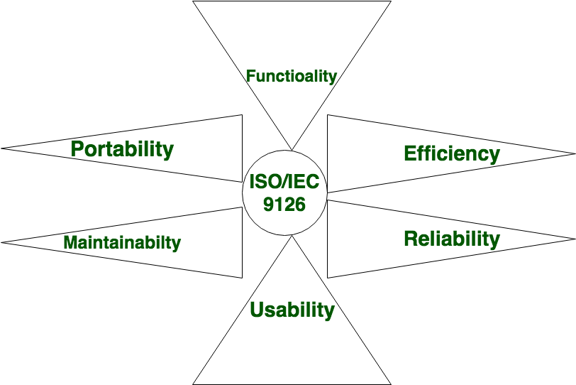
Software Characteristics

Slide 6
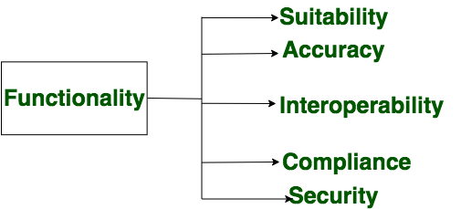
Functionality

Slide 7
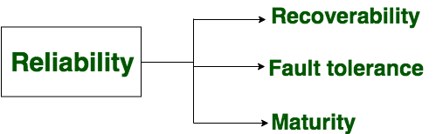
Reliability

Slide 8
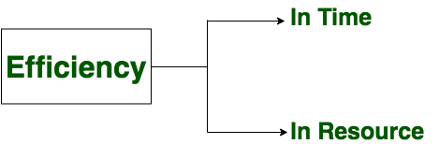
Efficiency

Slide 9
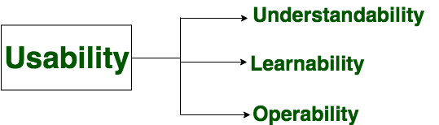
Usability

Slide 10
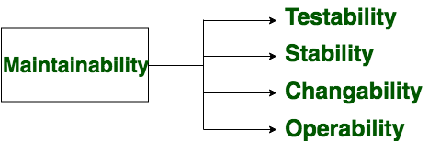
Maintainability

Slide 11
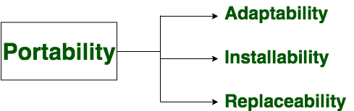
Portability

Slide 12
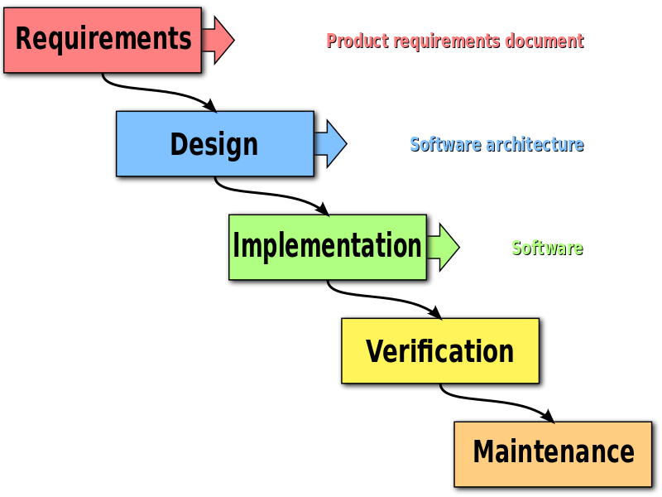
Waterfall Model (Sequential Model)

Slide 13
Waterfall model
The waterfall model is one of the most traditional and commonly used software development methodologies for software development. This life cycle model is often considered as the classic style of the software development. This model clarifies the software development process in a linear sequential flow that means that any phase in the development process begins only if the earlier phase is completed. This development approach does not define the process to go back to the previous phase to handle changes in requirements.

Slide 14
Waterfall model
Advantages of Waterfall Model:
Waterfall model is very simple and easy to understand and use a method that is why it is really beneficial for the beginner or novice developer
It is easy to manage, because of the rigidity of the model. Moreover, each phase has specific deliverables and individual review process
In this model phases are processed and completed are at once in a time thus it saves a significant amount of time
This type of development model works more effectively in the smaller projects where requirements are very well understood
The testing is easier as it can be done by reference to the scenarios defined in the earlier functional specification

Slide 15
Waterfall model
Disadvantages of Waterfall Model:
This model can only be used when very precise up-front requirements are available
This model is not applicable for maintenance type of projects
The main drawback of this method is that once an application is in the testing stage, it is not possible to go back and edit something
There is no possibility to produce any working software until it reaches the last stage of the cycle
In this model, there is no option to know the end result of the entire project
This model is good for a small project but not ideally suitable for long and ongoing projects
Not ideal for the projects where requirements are very moderates, and there is great scope for modification

Slide 16
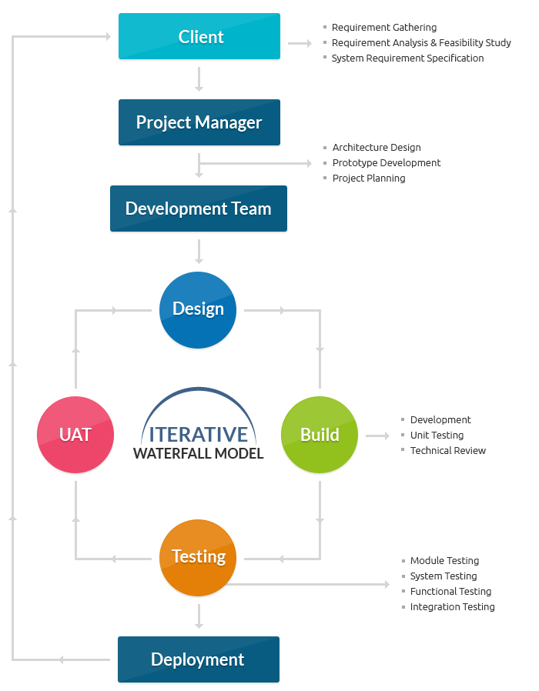
Waterfall Model

Slide 17
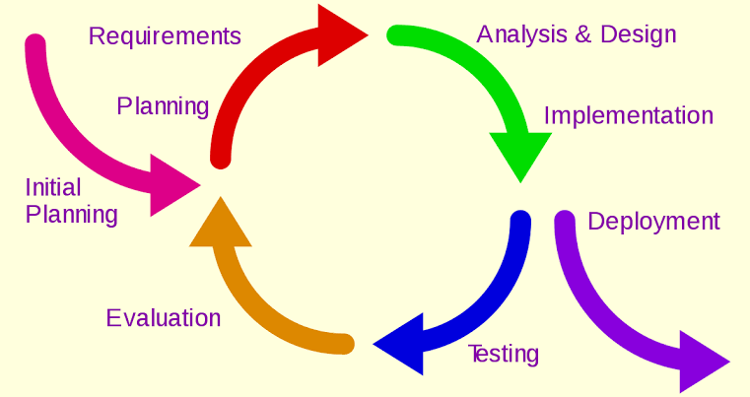
Incremental or Iterative Model

Slide 18
Incremental or Iterative Model
The basic idea behind this method is to develop a system through repeated cycles (iterative) and in smaller portions at a time (incremental), allowing software developers to take advantage of what was learned during development of earlier parts or versions of the system.
The possible key steps in the process start with a simple implementation of a subset of the software requirements and iteratively enhance the evolving versions until the full system is implemented.
At each iteration, design modifications are made and new functional capabilities are added.

Slide 19
Incremental or Iterative Model
The procedure itself consists of the initialization step, the iteration step, and the Project Control List. The initialization step creates a base version of the system. The goal for this initial implementation is to create a product to which the user can react. It should offer a sampling of the key aspects of the problem and provide a solution that is simple enough to understand and implement easily. To guide the iteration process, a project control list is created that contains a record of all tasks that need to be performed. It includes items such as new features to be implemented and areas of redesign of the existing solution. The control list is constantly being revised as a result of the analysis phase.

Slide 20
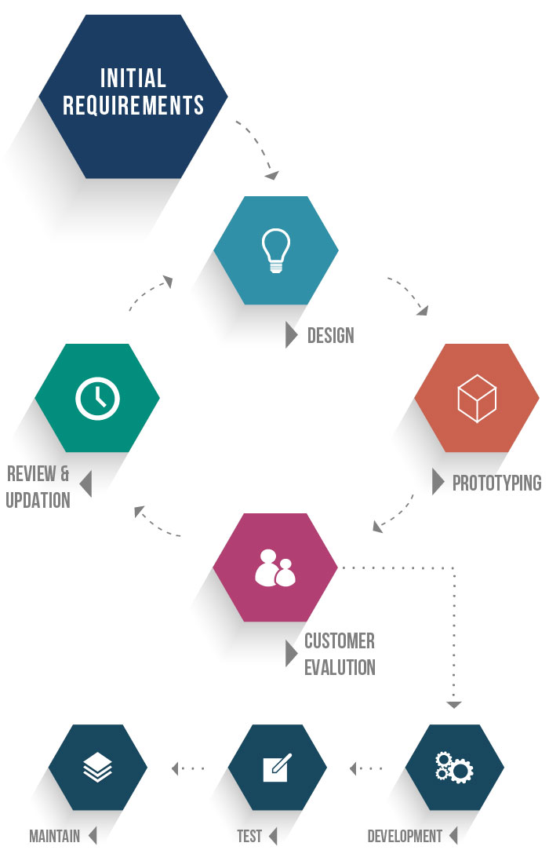
Prototype Model

Slide 21
Prototype Methodology
The prototype methodology is the software development process which allows developers to create only the prototype of the solution to demonstrate its functionality to the clients and make necessary modifications before developing the actual application. The best feature of this software development methodologies is that it solves many issues which often occur in a traditional waterfall model.

Slide 22
Prototype Methodology
Advantages of Prototype Model:
When a prototype is shown to the clients, they get a clear understanding and complete 'feel' of the functionality of the software
This method significantly reduces the risk of failure, as potential risks can be identified in early stage and moderation steps can be taken quickly
The communication between software development team and the client makes very good and conducive environment during a project
It helps in requirement gathering and requirement analysis when there is lack of requirement documents

Slide 23
Prototype Methodology
Disadvantages of Prototype Model:
Prototyping is usually done at the cost of the developer so, it is should be done using minimal resources otherwise organization’s development cost stretch too much
Too much involvement of client is not always favored by the software developer
Too many modifications may not good for the project, as it easily disturbs the workflow of the entire software development team

Slide 24
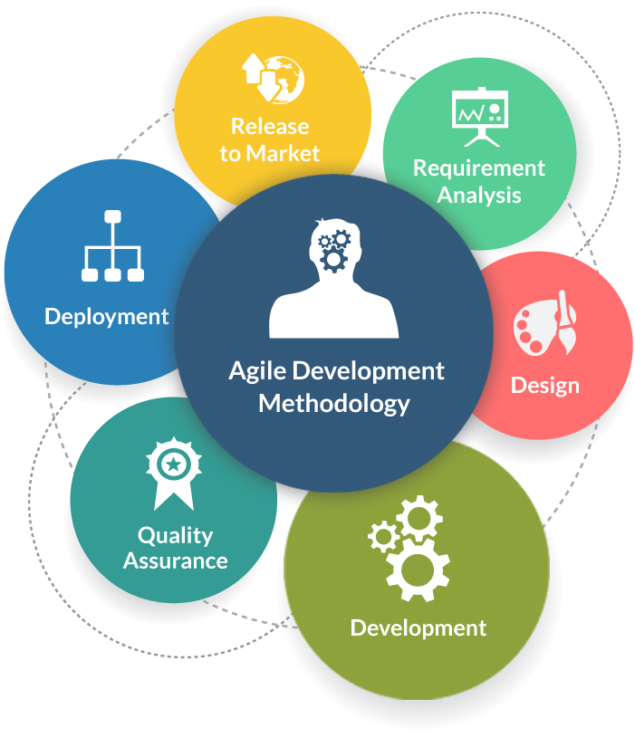
Agile Model

Slide 25
Agile Software Development Methodology
Agile Software Development is an approach that is used to design a disciplined software management process which also allows some frequent alteration in the development project. This is a type of software development methodologies which is one conceptual framework for undertaking various software engineering projects. It is used to minimize risk by developing software in short time boxes which are called iterations that generally last for one week to one month.

Slide 26
Agile Software Development Methodology
Advantages of Agile Development Methodology:
Agile methodology has an adaptive approach which is able to respond to the changing requirements of the clients
Direct communication and constant feedback from customer representative leave no space for any guesswork in the system

Slide 27
Agile Software Development Methodology
Disadvantages of Agile Development Methodology:
This methodology focuses on working software rather than documentation, hence it may result in a lack of documentation
The software development project can get off track if the customer is not very clear about the final outcome of his project

